Slide 1









My Number Interactive Notebook
$$×$$
$$\frac{1}{2}$$
$$÷$$
$$+$$
$$−$$
$$\frac{3}{5}$$
$$7$$
Name
Class
Teacher
Term 1 Semester 1
$$5^{2}$$
$$\sqrt{9}$$
1

Slide 2
If $300 is borrowed at a 10% pa simple interest.
How much do I owe after
1 year?
2 years?
5 years?

Slide 3
Contents
Glossary or Formula Page
Page
Date
Description
2
3

Slide 4
Tasks
24
7
30
Essential Question
Questions
Notes
Summary

Slide 5


24
7
30
Date
Simple Interest
EQ – How is Simple Interest calculated?

Slide 6
24
7
30
Date
Simple Interest
EQ – How is Simple Interest calculated?
What is the formula for simple interest?
1. If $300 is borrowed at a 10% pa simple interest for 5 years.
How much interest is paid?
What is the total amount repaid?
2. . If $4000 is invested and earns 4% pa simple interest for 3 years.
How much interest do you recieve?
How much is in the account at the end of the term?
Example

Slide 7
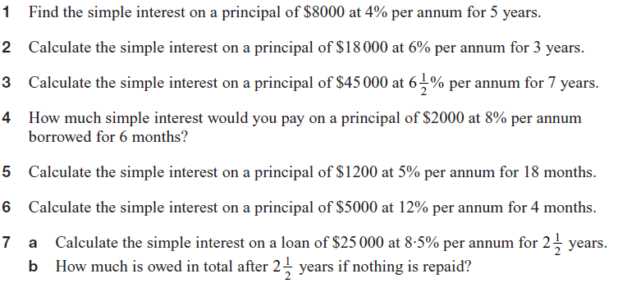
Task

Slide 8

Task
Answers

Slide 9
Notes Review
24, 7 ,30
Date
Title
Essential question
Notes complete
Notes complete with colour and diagrams
Questions completed
Contents page filed in
Formula page filled in

Slide 10
Homework
Review your notes and write a summary answering the essential question.

